Slide 1

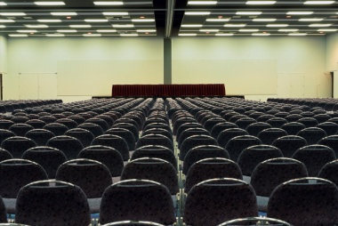
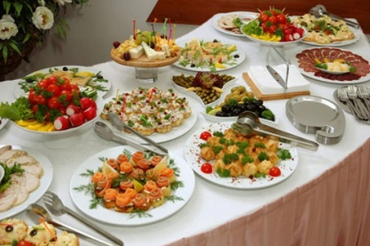
ORGANISE FUNCTIONS
D1.HSM.CL5.01 D1.HCS.CL6.04
Notes:
Trainer welcomes trainees to class.

Slide 2
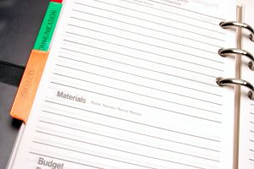
Subject Elements
This unit comprises four Elements:
Identify function facilities and procedures at the host establishment
Liaise with function customers
Prepare for functions
Follow-up after functions
Notes:
Trainer advises this Unit comprises four Elements, as listed on the slide explaining:
• Each Element comprises a number of Performance Criteria which will be identified throughout the class and explained in detail
• Trainees can obtain more detail from their Trainee Manual
• At times the course presents advice and information about various protocols but where their workplace requirements differ to what is presented, the workplace practices and standards, as well as policies and procedures must be observed.

Slide 3

Assessment
Assessment for this unit may include:
Oral questions
Written questions
Work projects
Workplace observation of practical skills
Practical exercises
Formal report from supervisor
Notes:
Trainer advises that assessment for this Unit may take several forms all of which are aimed at verifying they have achieved competency for the Unit as required.
Trainer indicates the methods of assessment that will be applied to them for this Unit.

Slide 4
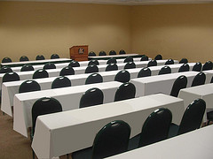
Element 1:
Identify function facilities and procedures at the host establishment
Notes:
Introduce topic.
Class Activity – General Discussion
Ask general questions:
What is a function?
What types of functions exist?
Who normally holds functions?
Where are they normally held?
What are the benefits of holding functions at a hotel?

Slide 5

Identify function facilities and procedures at the host establishment
Performance Criteria for this Element are:
Explain the role of the Functions Booking book
Identify the facilities available for functions
Identify the styles of functions that can be accommodated
Identify the styles of service available
Describe the function set-up options available
(Continued)
Notes:
Trainer identifies the Performance Criteria for this Element, as listed on the slide.

Slide 6
Identify function facilities and procedures at the host establishment
Performance Criteria for this Element are:
Describe the function menus available
Identify function costs for the customer
Develop a function kit
Identify the role of function-related documentation
Notes:
Trainer identifies the Performance Criteria for this Element, as listed on the slide.

Slide 7
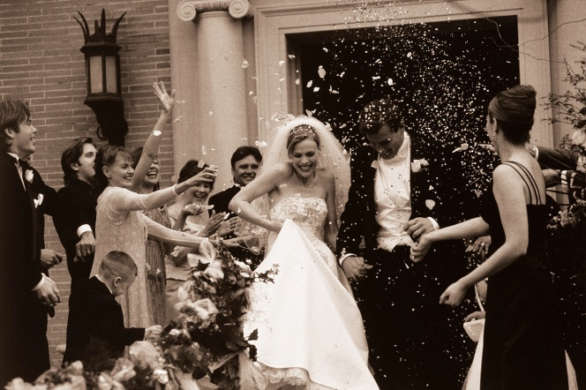
Functions
What is a function?
What functions have you been to in the past?
Notes:
Class Activity – General Discussion
Get audience to discuss the functions that they have attended in the past.

Slide 8

Benefits of functions
For the customer:
It saves time and stress
It allows for professional staff to have the responsibility for running a function
It provides access to a specialist venue, room size and equipment
The outcome is a product or service which cannot be produced elsewhere
Notes:
Class Activity – General Discussion & Questions
Get audience to think about local hotels.
What do they provide which cannot be replicated at home or at an office?

Slide 9

Benefits of functions
For a hospitality organisation
It is a major revenue source
It can appeal to a variety of market segments
It allows the organisation to promote itself by showcasing unique functions and events
It promotes creativity, skills and knowledge in staff
Notes:
Class Activity – General Discussion & Questions
Get the audience to think about the potential revenues generated through the following types of functions.
How much revenue is generated through a normal meeting?
How much revenue is generated through a wedding?

Slide 10

Functions Booking book
A functions booking book is the primary document that is used to record any tentative or confirmed functions that may be taking place in a hospitality establishment
This book is the first place a functions manager will look when a potential customer enquires about a function
Notes:
Class Activity – General Questions
Where is this book normally kept?
What formats does this ‘book’ come in?
What is recorded in this ‘book’?

Slide 11
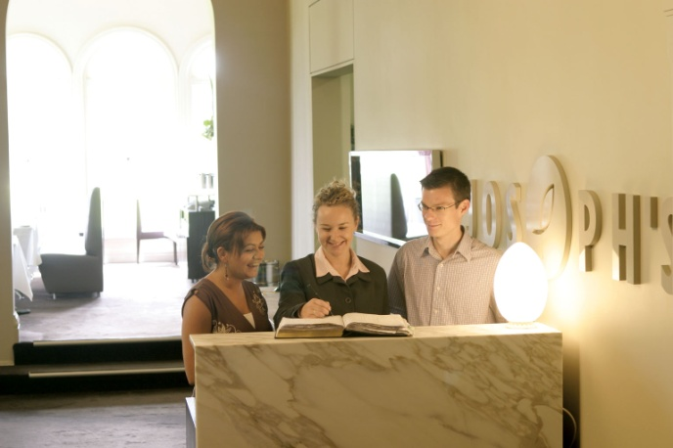
Functions Booking book
The information normally recorded includes details of functions that have been booked by:
Customer name and contact details
Day, date and time
Description of function
Room/location to be used
Approximate numbers attending
Notes:
Class Activity – Demonstration
Trainer to show example of Functions Booking book to audience.

Slide 12
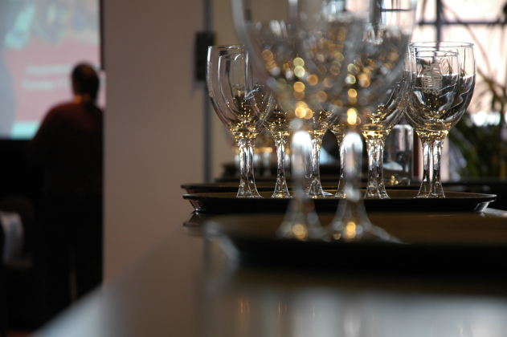
Functions facilities
In most hotels there is a dedicated area for functions, which can cater to a wide variety of activities comprising each function.
What areas/facilities can be used for functions within a hotel?
Notes:
Class Activity – General Questions & List function facilities
Answer question in slide
Get audience to list all the facilities/spaces that can be used for a function.

Slide 13
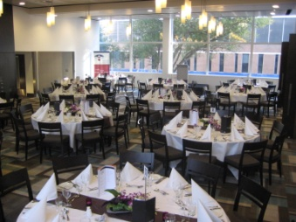
Functions facilities
Range of facilities
Meeting/conference room
Stand up conference areas
Banquet room
Exhibition bays and space
Notes:
Class Activity – General Questions
What is each facility used for?

Slide 14

Functions facilities
Range of facilities
Business centres
High-speed Internet access
Word processing
Photocopying
Faxing services
Computer access and rental
Faxing services
Notes:
Class Activity – General Questions
What costs are associated with each of these services?
The trainer may need to provide Business Centre Price list or audience to research.

Slide 15

Functions facilities
Range of facilities
Business centres
Office supplies
Packaging and shipping
Secretarial services
Courier service
Translations
Arrangement of transport
Notes:
Class Activity – General Questions
What costs are associated with each of these services?
The trainer may need to provide Business Centre Price list or audience to research.

Slide 16
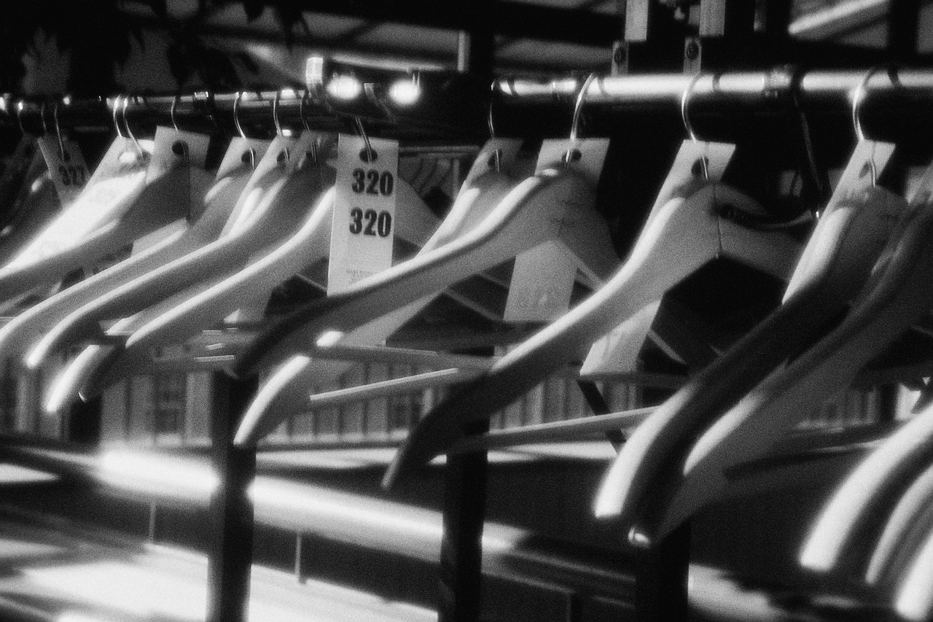
Functions facilities
Range of facilities
Auditoriums
Press rooms
Storage bays
Parking facilities
Change rooms
Notes:
Class Activity – General Questions
What needs to be included in a facility for the press?
What different types of storage areas are needed and for what purpose?

Slide 17
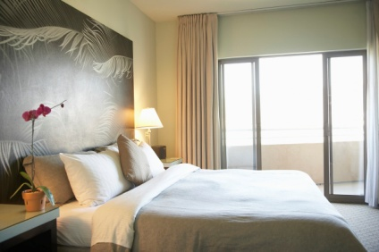
Functions facilities
Range of facilities
Display areas
Designated and discreet sections of restaurants and/or bars
Food and beverage service
Accommodation
Notes:
Class Activity – General Questions
What are restaurant and bar areas used for?
What food and beverage services are provided?
What are accommodation rooms used for?

Slide 18
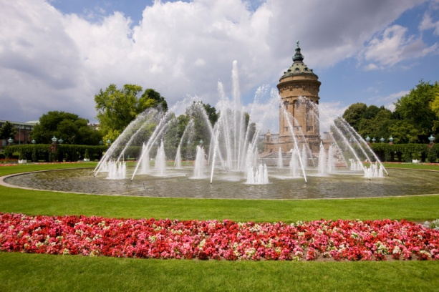
Functions facilities
Range of facilities
Sound and lighting
Communication technologies and equipment
Music facilities
Gardens
Notes:
Class Activity – General Questions
What types of sound and lighting is available? What are they used for?
What technology is used in functions?
What equipment is used in functions?
What are gardens normally used for?

Slide 19

Types of functions
Breakfasts
Lunches
Dinners
Seminars, workshops and conferences
Cocktail parties
General parties, birthdays & celebrations
Weddings/receptions
Notes:
Class Activity – General Questions
What types of food and beverage are served at these?
What facilities mentioned before would be appropriate to hold these functions?

Slide 20

Types of functions
Anniversaries
21st birthday parties
Product launches and distributor functions
School formal, annual dinners and dinner dances
Annual general meetings
Training seminars
Graduations and award nights
Notes:
Class Activity – General Questions
What types of food and beverage are served at these?
What facilities mentioned before would be appropriate to hold these functions?

Slide 21

Types of functions
Press receptions
Fashion shows
Special events
Tradeshows
Stage productions, including music events
Notes:
Class Activity – General Questions
What types of food and beverage are served at these?
What facilities mentioned before would be appropriate to hold these functions?

Slide 22

Types of functions
MICE
Many venues focus on the MICE sector of the industry.
MICE stands for:
Meetings
Incentives
Conferences
Events
Notes:
Class Activity – General Questions
What types of functions are associated with each category?
Why is the MICE sector very appealing to hotels as a key market to attract?

Slide 23

Types of functions
MICE
Meetings include general business meetings
Incentives refers to functions that businesses organise to reward or motivate staff
Conferences are usually business/industry based occasions where people get together to discuss issues and share knowledge
Events can include bands, concerts, entertainments
Notes:
Class Activity – General Discussion
Discuss these points.

Slide 24
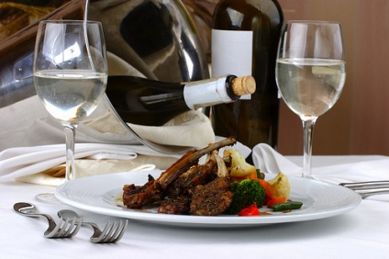
Styles of service
Plated service
Kitchen plates all the food and the waiting staff carry the plated food to the table.
The benefits of plated service are:
Consistency of meals
Fast service
Portion control
Notes:
Class Activity – General Questions
In what types of functions is this style of service popular?

Slide 25
Styles of service
Silver service
Food items are prepared and carved or separated into individual portions and placed on platters by kitchen staff.
Waiting staff use spoons and forks to serve food from service platters.
The benefits of silver service are:
Adds a dimension of ‘entertainment and sophistication’
Customers can have greater choice
Notes:
Class Activity – General Questions
In what types of functions is this style of service popular?

Slide 26
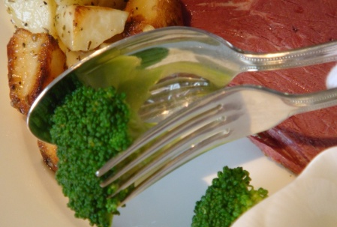
Styles of service
Semi silver service
Meat component of the dish is plated and served, and the vegetables are silver served.
The benefits of semi-silver service are:
Increases options for customer
A more time efficient use of silver service
Notes:
Class Activity – General Questions
In what types of functions is this style of service popular?

Slide 27
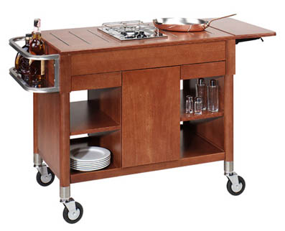
Styles of service
Gueridon service
Food is prepared or cooked at the table and served using full silver service techniques.
The benefits of gueridon service are:
It is a form of entertainment
It is interactive
Allows customers to see the cooking process
Meals can be prepared to customer’s exact specifications
Notes:
Class Activity – General Questions
In what types of functions is this style of service popular?

Slide 28
Styles of service
Buffet service
Food is prepared in kitchens in large quantities and then placed on a buffet or display table
In most buffet situations guests serve themselves and select the items and quantities they desire
Notes:
Class Activity – General Questions
In what types of functions is this style of service popular?

Slide 29
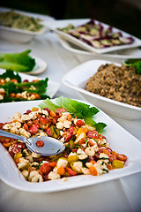
Styles of service
Buffet service
The benefits of buffet service are:
Customers have greater choice
They can have small amounts of different items as opposed to having one type of food
Service is very time efficient
Labour demands are reduced
Food can be prepared in advance
Notes:
Class Activity – General Questions
What is the role of staff in a buffet arrangement?

Slide 30

Styles of service
Cocktail service
This style of service is very popular, either as a prelude to a dinner or as a stand alone function in its own right
Waiters providing a range of finger foods and beverage to customers in a stand up function
Notes:
Class Activity – General Questions
In what types of functions is this style of service popular?

Slide 31
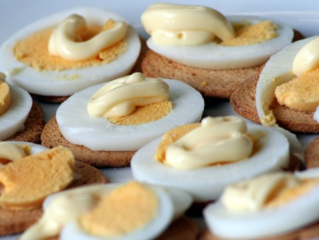
Styles of service
Cocktail service
The benefits of cocktail service are:
It has great flexibility in terms of both cost and item options
It is a cost effective method for clients to provide food and beverage to their participants
It can be performed within a limited time frame
It requires only a small space
Participants can mingle with each other easily
Notes:
Class Activity – General Questions
In what types of functions is this style of service popular?

Slide 32
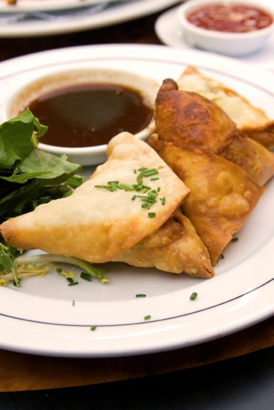
Function set up options
Stand-up function
This style of function is generally used for:
Cocktail parties
General parties
Lunches that are part of a conference
Notes:
Class Activity – General Questions
Discuss this set up option
What equipment items are required?

Slide 33
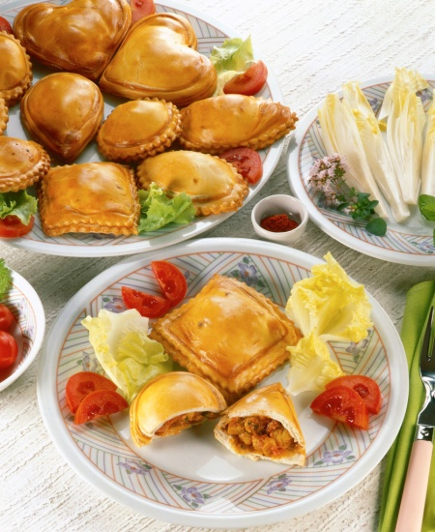
Function set up options
Stand-up function
The only seating might be around the edges of the room.
Several tables placed for:
Staff to place snacks
Guests to place drinks and any unwanted glassware, plates, food scraps
Notes:
Class Activity – General Questions
In what types of functions is this style of service popular?

Slide 34
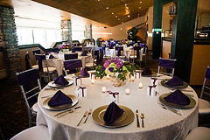
Function set up options
Sit down function
This style of function is generally used for:
Weddings
Formal dinners
Banquets
Presentations
Dinners for conferences
Notes:
Class Activity – General Questions
In what types of functions is this style of service popular?

Slide 35

Function set up options
Meetings
There are a number of styles to use when setting up a meeting
What set up options do you know?
Notes:
Class Activity – General Questions
Get the audience to answer the question in the slide.

Slide 36
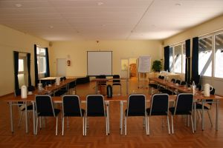
Function set up options
Meetings
Theatre style
Boardroom style
Hollow square
Classroom style
Banquet style
U Shape
E-shape
Notes:
Class Activity – General Questions
What are each of this set up options used for?
What are the benefits of each option?

Slide 37
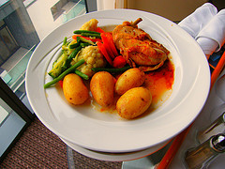
Function menu options
Menu considerations
Styles of functions
Styles of service required
Timing of functions
Providing a variety of price points
Having inclusive and non-inclusive menus
Notes:
Class Activity – General Questions
How can hotels provide a variety of price points?
What is the difference between inclusive and non-inclusive menus?

Slide 38

Types of food and beverage menus
The types and styles of food and beverage menus will vary greatly depending on:
Size and style of the venue
Type of function
Available budget
Client preferences
Nature of the function
Various timing factors
Notes:
Class Activity – General Discussion
Think about a range of different functions. What types of food and beverage would be appropriate?

Slide 39
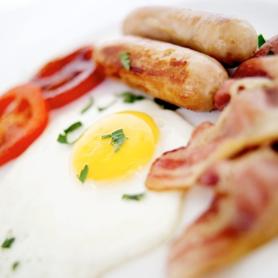
Types of food and beverage menus
Breakfast menu
Continental
Continental plus selected cooked food items
Continental plus full cooked food items
Food platters
Beverage items
Buffet breakfast for large numbers
Full breakfast
Notes:
Class Activity – General Discussion
Trainer to discuss the different menu items and how they would best be served.
Trainer may show examples of menus relating to this meal period.
Continental
Continental plus selected cooked food items
Continental plus full cooked food items
Food platters – fruit and bakery items, intended as finger food
Beverage items – coffee, tea, juices
Buffet breakfast for large numbers
Full breakfast – cereal, juices, cooked main items, toast, tea and coffee: served to seated guests.

Slide 40

Types of food and beverage menus
Morning/afternoon teas
Selection of pastries and bakery items
Selection of open or closed sandwiches
Selection of biscuits and cake
Selection of petit fours
Beverage items
Notes:
Class Activity – General Discussion
Trainer to discuss the different menu items and how they would best be served.
Trainer may show examples of menus relating to this meal period.

Slide 41

Types of food and beverage menus
Lunch menu
Buffet of selected hot and cold items
Set menu
Platters of sandwiches, filled rolls
Platters of cakes, biscuits, pastries and petit fours
Platters of fruit, fruit and cheese, cheese and greens
Beverages
Notes:
Class Activity – General Discussion
Trainer to discuss the different menu items and how they would best be served.
Trainer may show examples of menus relating to this meal period.
Buffet of selected hot and cold items – may include an entrée, main course and dessert, or any combination
Set menu (to a specific number of courses) – can be served to seated guests or presented for buffet style service
Platters of sandwiches, filled rolls – sandwiches and rolls may be open or closed
Platters of cakes, biscuits, pastries and petit fours
Platters of fruit, fruit and cheese, cheese and greens
Beverages – selection of alcoholic and non-alcoholic beverages which may include full bar, selected and minimal liquor, or non-alcoholic beverages only comprising aerated waters, waters, fruit juices, mocktails.

Slide 42

Types of food and beverage menus
Dinner menu
Set menu or buffet style
Entrée
Main course
Dessert, or any combination
Beverages – alcoholic and non-alcoholic
Notes:
Class Activity – General Discussion
Trainer to discuss the different menu items and how they would best be served.
Trainer may show examples of menus relating to this meal period.
Set menu (to a specific number of courses) – can be served to seated guests or presented for buffet style service. Dinners are more commonly a seated affair where lunches tend to be buffet style
Buffet of selected hot and cold items – may include an entrée, main course and dessert, or any combination. More time is traditionally available for dinners whereas with lunches there tends to be a tighter time frame as people need to return to meetings, groups or activities by a given time
Beverages – there may be a selection of alcoholic and non-alcoholic beverages. There may be a set number of specific wines set on each table – above that, guests may be required to pay for what they want, or there may be a full bar facility.

Slide 43
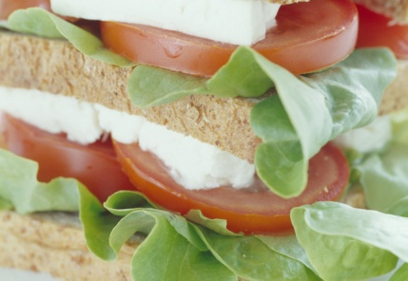
Types of food and beverage menus
Seminar/conference
Usually a selection of light refreshments
Buffet style or finger food style
Morning and afternoon teas
Beverages – tea, coffee, juices and water
Notes:
Class Activity – General Discussion
Trainer to discuss the different menu items and how they would best be served. Trainer may show examples of menus relating to this meal period.
Usually a selection of light refreshments - small sandwiches and rolls etc. compared to substantial menu items; the idea being not to send the people off to sleep. There is a definite need to include healthy options such as fruit
Commonly these meals are buffet style or finger food style to keep costs down, and to facilitate the concept of people networking at the function
Morning and afternoon teas are common – with pastries, cakes and biscuits rotating throughout the time of the conference
Beverages – alcohol is less common, but not unknown; non-alcoholic beverages include tea and coffee, and water
Tea, coffee, water and pastries may be served to guests on arrival in the morning while people are arriving, registering and mingling.

Slide 44
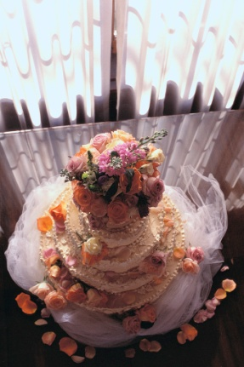
Types of food and beverage menus
Wedding
Commonly a set menu specifying the number of courses to be served, and the style to be used
Can also feature a buffet of hot and cold food items
Beverages may be a nominated selection of alcoholic and non-alcoholic beverages, full bar, or guests pay as they go
Notes:
Class Activity – General Discussion
Trainer to discuss the different menu items and how they would best be served.
Trainer may show examples of menus relating to this meal period.

Slide 45
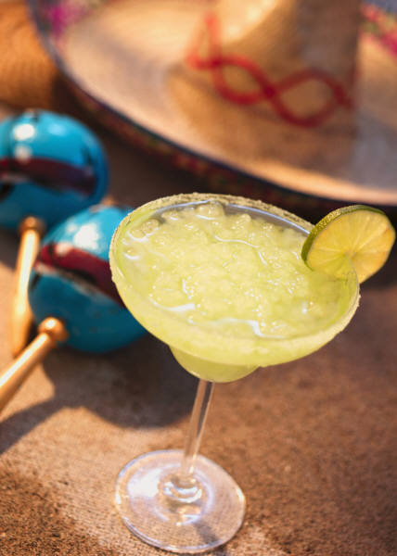
Types of food and beverage menus
Cocktail parties
Platters of hors d’oeuvre and canapés can be presented in a buffet style, or served by waiting staff
Beverages are usually a nominated selection of alcoholic and non-alcoholic beverages up to a set dollar figure, or for a given time period
Notes:
Class Activity – General Discussion
Trainer to discuss the different menu items and how they would best be served.
Trainer may show examples of menus relating to this meal period.

Slide 46

Types of food and beverage menus
Promotions and product launches
Generally features a selection of light refreshments – small sandwiches, rolls, canapés, muffins and other finger food
Beverages may be dictated by the nature of the promotion
Notes:
Class Activity – General Discussion
Trainer to discuss the different menu items and how they would best be served.
Trainer may show examples of menus relating to this meal period.

Slide 47

Types of food and beverage menus
Client providing own items
It is not uncommon for the customer to bring some of their own items to suit the requirements of the occasion.
For birthdays and weddings it is normal for the customer to bring their own:
Cakes
Speciality wines
Decorations
Notes:
Class Activity – Questions
What items do hotels allow and not allow clients to bring?
What rules or charges apply when clients bring their own food and beverage items?

Slide 48

Types of food and beverage packages
There are many different types of menus options that are available to customers.
To keep it simple, functions present three common package options:
Inclusive
On consumption
On cash basis
Notes:
Class Activity – Questions
What is the difference between these types of packages?
What types of functions commonly use each package?

Slide 49
Types of food and beverage packages
Inclusive packages
This is where an all-up price is quoted to the host for the function and the price includes nominated food and beverages
Same price regardless of how much of the agreed food and beverages are consumed
It includes a set, negotiated range of drinks but does not stipulate quantities
Notes:
Class Activity – Questions
When is this package used?
What are the benefits of this package type?

Slide 50

Types of food and beverage packages
Inclusive packages
Open bar
An open bar is where the guests at the function can order drinks without paying for them. The client settles the account at the end.
Open bars may be a:
‘Full bar’
‘Restricted’ bar
Notes:
Class Activity – Questions
When is this package used?
What are the benefits of this package type?
Open bars may be ‘full bar’ meaning there is no restriction at all as to what guests can order
Open bars can also be ‘restricted’ meaning the drinks served to guests may be restricted to selected items.

Slide 51
Types of food and beverage packages
On-consumption basis
Only what is consumed is charged for
Client usually sets a limit above which guests pay for their own
Notes:
Class Activity – Questions
When is this package used?
What are the benefits of this package type?

Slide 52

Types of food and beverage packages
Cash basis
This is a growing option as this style of service reduces the expense incurred by the host
Cash bars are common
Guests pay for all their own drinks either obtaining them at the bar or via waiter service
Notes:
Class Activity – Questions
When is this package used?
What are the benefits of this package type?

Slide 53

Types of function costs
Room and facility hire
Food and beverage
Decorations
Specialist staff
Bands and entertainers
Accommodation
Special requests
Notes:
Class Activity – Discussion and Research Activity
Discuss the different types of function costs.
Trainer to get the audience to identify cost items under each category and provide some approximate costs charged by different hotels.
Room and facility hire – this is normally the standard expenses with any function, ranging from a set rate for a day or rented on an hourly basis. This expense is normally included in large package deals such as a ‘meeting package’
Food and beverage – including ‘on arrival’ and during function as well as refreshments
Decorations – basic items such as candles and flowers through to elaborate themes
Specialist staff as required depending on the nature of the function – including translators, Technical IT and lighting experts, security
Bands and entertainers – these are quite common at events such as weddings and parties
Accommodation – discounted rates are normally provided to large functions
Special requests – these could be endless to suit the needs of each function.

Slide 54

Function Kit
Purpose of a Function Kit
Many establishments have a ‘Function Kit’ to:
Assist in providing advice to clients
Demonstrate the venue’s expertise and ability in relation to events and functions
Notes:
Class Activity – Question
What are the benefits of a function kit to both function staff and clients?

Slide 55

Function Kit
Benefits of a Function Kit
By establishing a function kit, it enables clients to:
Have all the necessary options and information at their disposal
Helps them to decide on the best options to suit their needs
Notes:
Class Activity – Question
What is included in a Function Kit?

Slide 56
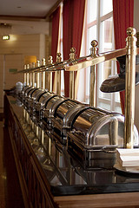
Function Kit
Contents of a Function Kit
Details and information in relation to:
Venue size
Capacity of rooms
Rooms/areas available
Venue facilities, services and equipment
Items that can be hired
Sample food and beverage menus
Notes:
Class Activity – Review of document and Research Activity
Trainer to show audience a range of different function kits
Audience to research and gather different types of function kits from various establishments including, hotels, function centres, wedding reception areas etc.

Slide 57

Function Kit
Contents of a Function Kit
Details and information in relation to:
Price Lists
Suggested staffing levels for functions
Colour photographs of different room set-up
Contact details of the venue
A DVD of the venue with a focus on functions
Notes:
Class Activity – Review of document and Research Activity
Trainer to show audience a range of different function kits
Audience to research and gather different types of function kits from various establishments including, hotels, function centres, wedding reception areas etc.

Slide 58

Function related documentation
There is a vast amount of documentation that is used in the planning and coordination of functions.
What documents need to be completed within the functions department?
Notes:
Class Activity – Review of documents
Trainer to show audience a range of different function related documentation.

Slide 59

Function related documentation
Documentation for different stakeholders
Documents may be produced for:
Internal staff
Suppliers
Clients
Notes:
Class Activity – Questions
What documents are needed by each stakeholder?

Slide 60

Function related documentation
General documentation
Function kits
Running sheet
Function sheet
Quotations from third party providers
Invitations
Notes:
Class Activity – Questions and Review of documents
What is the purpose of these documents?
Trainer to show audience examples of these documents

Slide 61

Function related documentation
General documentation
Food menus
Wine lists
Drink lists
Service vouchers
Equipment lists
Notes:
Class Activity – Questions and Review of documents
What is the purpose of these documents?
Trainer to show audience examples of these documents.

Slide 62
Function related documentation
Financial and Operation documents
Customer accounts
Quotations
Purchase orders
Invoices to the client
Statements for the client
Notes:
Class Activity – Questions and Review of documents
What is the purpose of these documents?
Trainer to show audience examples of these documents.

Slide 63

Function related documentation
Financial and Operation documents
Receipts
Post function reports
Staff time sheets
Function confirmation forms/letters
Customer feedback form
Notes:
Class Activity – Questions and Review of documents
What is the purpose of these documents?
Trainer to show audience examples of these documents.

Slide 64

Function related documentation
Participant documents
Access and security passes
Service vouchers
Information packs
Service vouchers
Name tags and lanyards
Conference materials such as compendiums, satchels, literature, stationery
Notes:
Class Activity – Questions and Review of documents
What is the purpose of these documents?
Trainer to show audience examples of these documents.

Slide 65

Element 2:
Liaise with function customers
Notes:
Introduce topic.
Class Activity – General Discussion
Ask general questions:
Who does a function staff member need to liaise with?
What are common methods of communication used?

Slide 66
Liaise with function customers
Performance Criteria for this Element are:
Determine customer needs
Identify date and time of function
Match establishment resources to identified need for function
Provide advice and assistance in relation to the function
(Continued)
Notes:
Trainer identifies the Performance Criteria for this Element, as listed on the slide.

Slide 67
Liaise with function customers
Performance Criteria for this Element are:
Record function requirements as agreed by customer
Confirm function booking with customer
Obtain deposit for function
Notes:
Trainer identifies the Performance Criteria for this Element, as listed on the slide.

Slide 68

Determine customer needs
Before any event or function can be organised there is a need to determine client need for it
The most effective way to do this is to meet face to face with the client and talk to them about their needs, wants and preferences.
Notes:
Class Activity – Questions
What is the purpose of an initial meeting?
What should be done or discussed in an initial meeting?

Slide 69
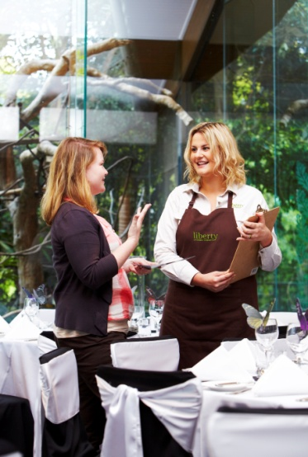
Determine customer needs
Meeting with the client
After receiving an enquiry regarding an event or function it is best practice to invite the client to your venue to:
Talk to them about their expectations and needs
Allow them to view the property and its facilities
Meet some of the key staff
Notes:
Class Activity – Questions
Where should this meeting take place?
What documents should you have at your disposal?

Slide 70
Determine customer needs
Types of customer needs
A specific day and date
Style and format of function
Location
Timing and duration considerations
Food and beverage
Accommodation
Notes:
Class Activity – Discussion
Discuss points.

Slide 71

Determine customer needs
Types of customer needs
Entertainment
Specialist technology services
Equipment
Ancillary services and rooms
Guest numbers
Privacy
Budget
Notes:
Class Activity – Discussion
Discuss points.

Slide 72

Determine customer needs
Types of customer needs
Access
Security
Themes and decorations
Role of media
External providers
Notes:
Class Activity – Discussion
Discuss points.

Slide 73

Researching options for functions
The nature of functions can be that clients are looking for ‘something new’ or ‘something different’ for their function
Whether as a response to a potential customer or as a professional development exercise, it is always advantageous to explore new concepts and ideas that can be integrated into current operations
Notes:
Class Activity – Questions
How can you gather new ideas that can improve your offering to a client?

Slide 74

Researching options for functions
Researching information
The standard ways to maintain awareness of new ideas and items that could be of use are:
Networking with others
Talking to suppliers
Doing online research
Attending functions
Subscribing to industry publications
Notes:
Class Activity – Discuss points
Networking with others – this can including forming a business relationship with other venues that offer functions and talking to them about what they are doing, initiatives they are aware of
Talking to suppliers – especially those who are in the functions sector and can be expected to provide equipment etc. to support these occasions. Personally visiting suppliers is also worthwhile
Doing online research – to view the items available from suppliers and search ‘events and functions’ to identify new sites and ideas
Attending functions – you should strive to attend as many as you can to pick up ideas
Subscribing to industry publications.

Slide 75

Matching resources to match client needs
Once all the customer needs have been identified, it is important to try to demonstrate how these needs can be met
There are a number of ways function staff can help to demonstrate they have the capacity to handle customer requirements
Notes:
Class Activity – Questions
How can you do this?

Slide 76
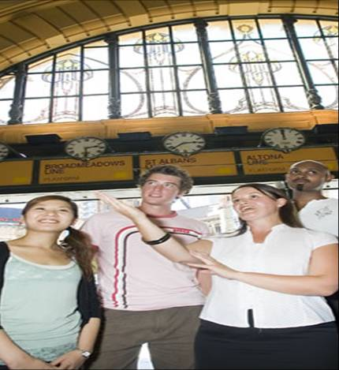
Matching resources to match client needs
Describing function facilities and options available
Giving Function Kit to customer and explaining the contents
Providing guided tour of premises and facilities to customer
Notes:
Class Activity – Questions
What is the best way to describe facilities and options?
What changes would you make to the Function Kit before giving it to the client?
What parts of the facility would you include in a tour?

Slide 77
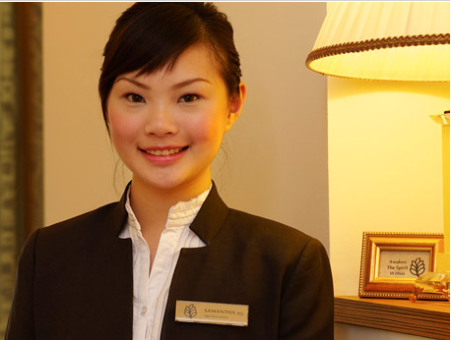

Matching resources to match client needs
Meeting key staff
Property owner or manager
Head Chef
Food and Beverage manager
Front Office manager
Bar manager
Dining room manager
Head housekeeper
Entertainment/event manager
Functions manager
Head of Security
Notes:
Class Activity – Questions
Why would each of these managers be included?

Slide 78
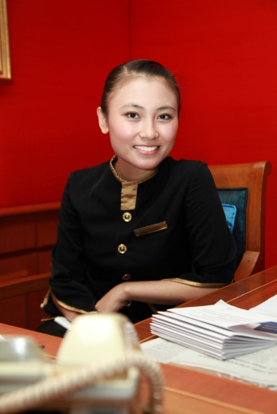
Matching resources to match client needs
Benefits of meeting key staff
Meeting key staff is beneficial as it:
Demonstrates the value you place in the customer
The customer can build confidence in the organisation
Enables each department to explain technical details
Notes:
Class Activity – Discussion
Discuss importance of each point.

Slide 79

Matching resources to match client needs
Benefits of meeting key staff
It puts a face to a name, for both parties
It enables each department to gain a detailed understanding of the customer’s needs
Enables staff members to confirm if specific requests can be met or any alterations that need to take place
Notes:
Class Activity – Discussion
Discuss importance of each point.

Slide 80

Matching resources to match client needs
Advising customer in relation to details of the provision of similar functions
A range of ways in which to build customer confidence in your ability to meet the customer’s needs include:
Showing pictures of previous events
Inviting them to view a similar event that is coming up
Arranging past customers to provide a reference
Notes:
Class Activity – Role play
Trainer to get the audience to break into pairs where one person is the Functions Manager and the other is the prospective client.
The Functions Manager must:
Gain an understanding of the client needs for a function of their choice
Be able to provide a suitable explanation of how these needs can be catered for.

Slide 81
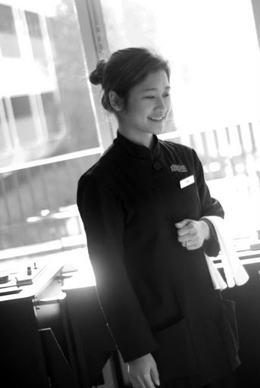
Providing options and suggestions
Function logistics
Location
Service styles
Room layouts
Timing considerations
Entertainment options
Ancillary services
Notes:
Class Activity – Discussion
Discuss importance of each point.

Slide 82
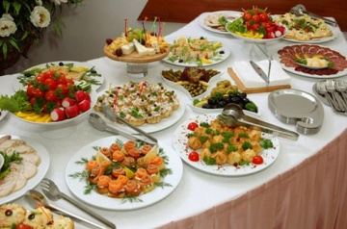
Providing options and suggestions
Food options
This can include refining or adjusting choices presented in standard ‘function kit’ options by:
Changing dishes
Altering serve sizes
Changing vegetables or salads
Providing detailed explanation
Suggesting number of items
Suggesting items that compliment each other
Notes:
Class Activity – Discussion
Discuss importance of each point.

Slide 83
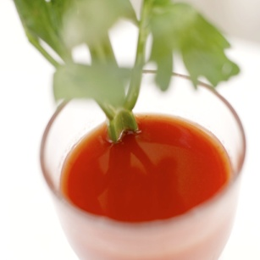
Providing options and suggestions
Beverage options
You will be expected to provide advice in relation to how much drink will be required to cater for those attending the event.
Factors to consider are:
Time of day
Gender and age of those attending
Type of function
Whether or not those attending are staying in-house
Notes:
Class Activity – Discussion
Discuss importance of each point.

Slide 84

Providing options and suggestions
Other options
Whilst the list may be endless, you may provide advice on:
Timing of activities
Weather
Dress codes
Transportation
External suppliers
Technical requirements
Seating arrangements and theming
Notes:
Class Activity – Discussion
Discuss importance of each point.

Slide 85

Maximise sales opportunities
Identify and pursue additional sales opportunities
It is not a good idea to provide suggestions solely based on improving the revenue of an event
However in many cases, your suggestions may prove to be advantageous to both parties
Notes:
Class Activity – Questions
How can you identify a sales opportunity?
What sales strategies can you use?

Slide 86

Maximise sales opportunities
Keys to identifying and pursuing additional sales
Present the additional sales opportunities as ‘options’ and not as necessities
Accept the client’s rejection of suggestions without being judgemental
Sell the benefits of the suggestion
Explain the suggestion
Give examples and explain impact it had
Provide samples
Notes:
Class Activity – Discuss points
Present the additional sales opportunities as ‘options’ and not as necessities. Never give the client the impression you are trying to force the suggestions on to them
Accept the client’s rejection of suggestions without being judgemental, without giving the client the impression they have made a poor decision or without giving the client the impression you are annoyed at them not accepting your suggestion
Sell the benefits of the suggestion. Make the client aware of the benefits they may bring, such as extra enjoyment, increased prestige and better value for money
Explain the suggestion – describe what it is all about, what it entails, when it might be used, detail what it would complement
Give examples of where you have seen the option included in an function and the impact it had, including positive feedback received from guests and clients
Provide samples. If you are trying to convince the client to include spa treatments for guests at a week-long conference, and then let the client experience a massage.

Slide 87
Record function requirements
Throughout the meeting with the potential client it is important to write down detailed notes as the discussion takes place
In many cases, there are many dimensions to a function and it is not expected that a functions staff member will be able to remember everything that the client says or requests
Notes:
Class Activity – Questions
Why is it important to write down information provided by the client?

Slide 88

Record function requirements
Record decisions
It is best to let the client know at the start of the meeting that you will be recording information
This will help put them at ease that nothing will be forgotten
Use dedicated templates broken down
Templates help guide or list of questions in which should be asked
Notes:
Class Activity – Questions
What templates would you use?
What information would you include in a template?

Slide 89

Record function requirements
Repeating information
At this stage, the key is to ensure that the information that you have recorded is:
Accurate
A true reflection of what the client is looking for
Notes:
Class Activity – Questions
Why is it important to repeat information to the client whilst they are still in your presence?

Slide 90

Provide quotation to client
All potential clients will need to be supplied with a quotation for their function before they commit to booking it and paying a deposit.
What should be included in a quotation?
Notes:
Class Activity – Questions
Discuss question in the slide and list items.

Slide 91
Provide quotation to client
Factors to take into account when developing a costing
Follow house policies
Make sure everything is charged for
Only include services and products the client has requested
Double-check your figures
Notes:
Class Activity – Discussing points to consider when preparing a quotation
Discuss steps associated with each factor.

Slide 92

Provide quotation to client
Factors to take into account when developing a costing
Identify and explain every charge
Observe promises made
Verify with management
Present the quotation in person
Notes:
Class Activity – Discussing points to consider when preparing a quotation
Discuss steps associated with each factor.

Slide 93
Negotiate and agree upon final event details
All functions and events require some form of negotiation with the client due to the individual nature of the occasions and the unique needs and preferences of the client.
Notes:
Class Activity – Questions
What aspects of the quotation or a booking are hotels willing to negotiate on?

Slide 94
Negotiate and agree upon final event details
Price
Where price is an issue the primary way of reducing it is to reduce what is to be offered.
This may include:
Reducing courses at a meal
Substituting a less expensive wine for the wines already quoted on
Substituting less expensive menu items into the meal options
Not including liquor in the function
Limiting the time the function runs
Removing a previously identified activity from the function
Notes:
Class Activity – Discuss points.
Reducing courses at a meal – from three to two
Substituting a less expensive wine for the wines already quoted on
Substituting less expensive menu items into the meal options
Not including liquor in the function – meaning guests have to pay for their own
Limiting the time the function runs which can reduce staffing costs
Removing a previously identified activity from the function such as the band or having a smaller band, entertainment, side tours and other inclusions.

Slide 95

Negotiate and agree upon final event details
Timing
Timing negotiations can also include discussion and agreement about:
Days the function is to be held
Timing of guest arrival
Timing of activities within the function itself
Access to the function area for client personnel
Times/dates by which the event must be finished
Notes:
Class Activity – Discuss points.
Days the function is to be held. Your venue may be able to offer a better deal at a time when business is traditionally slow
Timing of guest arrival. Staff costs can be reduced by shortening the amount of time between guest arrival and the start of the function
Decisions regarding the timing of activities within the function itself such as when meals are to be served, when different courses are to be served, when speeches are to take place, when morning and afternoon teas are to be served
Access to the function area for client personnel
Times/dates by which the event must be finished.

Slide 96
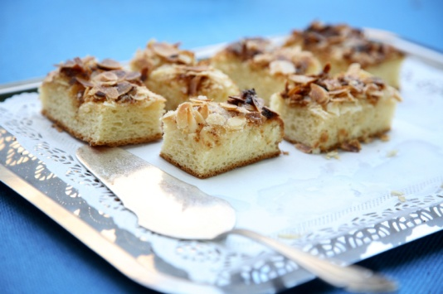
Negotiate and agree upon final event details
Goods and services to be provided
It may be possible to assist the client by curtailing expenses in terms of:
Providing their own cake
Proving cheaper dessert items
Removing the ‘pre-event’ drinks
Decreasing the amount, or changing the type of, decorations to be supplied
Eliminating flowers
Not including accommodation
Notes:
Class Activity - Discuss points

Slide 97

Preparing the Function Contract
Once the function details have been verbally confirmed with the customer, standard practice requires:
A written agreement to be drawn up
Is signed by all parties involved
Notes:
Class Activity – Questions
What information should be included in the Function Contract?

Slide 98
Preparing the Function Contract
Contents of a Function Contract
Full contact details of the client
Dates and times of the function
Date for notification of final numbers
Type of function
Service style
Seating arrangements
Equipment
Notes:
Class Activity – Discuss points in a contract
Discuss each point and important aspects to be recorded in each point.

Slide 99
Preparing the Function Contract
Contents of a Function Contract
Location of the function, name of rooms and facilities to be used
Approximate numbers attending
Décor, displays and table decorations
Food to be served – including when, type, amount
Beverages to be served
Entertainment, activities and inclusions
Notes:
Class Activity – Discuss points in a contract
Discuss each point and important aspects to be recorded in each point.

Slide 100
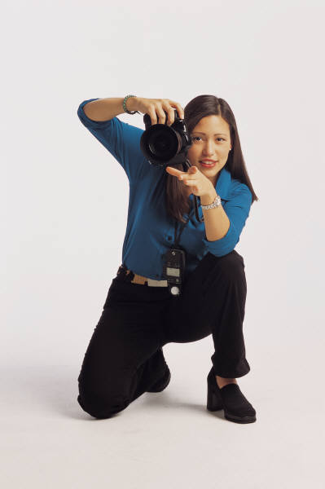
Preparing the Function Contract
Contents of a Function Contract
Ancillary sales:
Accommodation by type, number and dates
Tours
In-house services
Provision of a master of ceremonies (MC) or host
Photographers
Notes:
Class Activity – Discuss points in a contract
Discuss each point and important aspects to be recorded in each point.

Slide 101
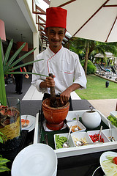
Preparing the Function Contract
Contents of a Function Contract
Services and facilities the venue has agreed to provide at no charge
Technology required
Access required by the client prior to the function
Products and services the client will be supplying
Involvement of third party suppliers
Total cost of function
Notes:
Class Activity – Discuss points in a contract
Discuss each point and important aspects to be recorded in each point.

Slide 102
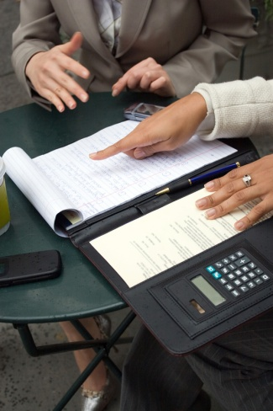
Preparing the Function Contract
Booking conditions
All venues will have specific booking conditions. These will usually appear on the website and form part of the standard function contract.
What information is normally included in booking conditions?
What are the benefits of having booking conditions?
Notes:
Class Activity – Questions
Ask questions in the slide.

Slide 103

Preparing the Function Contract
Contents of Booking Conditions
How long the client has before signing the function contract
Need for the client to provide information by a set date
Need for the client to advise the venue within a set time of any inaccuracies contained in the contract or running sheet
Ability of the client to make changes to expected numbers
Notes:
Class Activity – Discuss points in booking conditions
Discuss each point and important aspects to be recorded in each point.

Slide 104
Preparing the Function Contract
Contents of Booking Conditions
Payment requirements
Cancellation policy
Right of the venue to make changes
‘Force majeure’
Right of the venue to refuse certain activities or individuals
Notes:
Class Activity – Discuss points in booking conditions
Discuss each point and important aspects to be recorded in each point (information explaining each point can be found in the Trainee Manual).

Slide 105
Preparing the Function Contract
Contents of Booking Conditions
Conditions that apply to decorating and using the venue
Loss and damage
Check-in and check-out times for accommodation rooms that are being included as part of the function
Notes:
Class Activity – Discuss points in booking conditions
Discuss each point and important aspects to be recorded in each point.

Slide 106
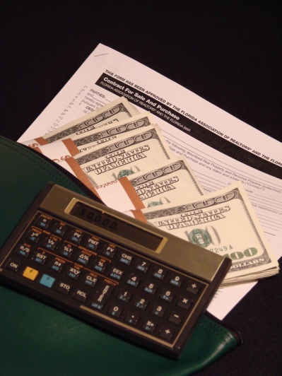
Obtaining deposit for function
It is standard industry practice to request a deposit when the final details of a function have been confirmed
No function exists until a deposit has been paid
Notes:
Class Activity – Questions
What is the standard practice for requesting a deposit?
How much deposit is normally required?

Slide 107

Obtaining deposit for function
Requesting the deposit
You may have blocked the required areas for an anticipated function, but it remains ‘tentative’ until a deposit has been secured and a contract signed.
How can you make a request for a deposit to be paid?
Notes:
Class Activity – Questions
Ask questions in the slide.

Slide 108

Obtaining deposit for function
Requesting the deposit
Methods include:
In writing
Over the phone
By email
In a face to face meeting
Notes:
Class Activity – Questions
Which is the most preferred method and why?

Slide 109

Obtaining deposit for function
Steps associated with handling deposits
Requesting deposit payment
Setting date for payment of deposit
Advising of payment options
Issuing receipt for deposit and confirmation
Recording payment of deposit on internal documentation
Advising customer of amount outstanding
Notes:
Class Activity – Discuss the actions associated with each step when handling deposits

Slide 110

Updated financial information
When the client pays a deposit for a function an account is usually opened for them at this stage.
Updating information can include:
Ensuring payment entries are recorded
Updating files when new payments are made
Notes:
Class Activity – Discuss the points in the slide

Slide 111

Preparing confirmations
A standard pro forma confirmation is sent to the client when they have signed the function contract and paid a deposit
This confirmation acknowledges the contract has been signed and that money has been paid and received
In addition a copy of Function Sheet is also sent
Notes:
Class Activity – Questions
What is the best way to send a confirmation and why?

Slide 112
Element 3:
Prepare for functions
Notes:
Introduce topic.
Class Activity – General Discussion
Ask general questions:
What activities need to be prepared for functions?

Slide 113
Prepare for functions
Performance Criteria for this Element are:
Maintain and update Function Sheet
Advise colleagues and staff in relation to function
Roster staff for function
Minimise impact of function on normal establishment operation
Arrange for external services as identified
Purchase necessary stock for function
(Continued)
Notes:
Trainer identifies the Performance Criteria for this Element, as listed on the slide.

Slide 114
Prepare for functions
Performance Criteria for this Element are:
Prepare Running Sheet for function
Conduct pre-function briefings
Finalise function details with customer, colleagues and staff
Monitor set-up for the function
Monitor service delivery of function
Notes:
Trainer identifies the Performance Criteria for this Element, as listed on the slide.

Slide 115
Preparing function sheets
What is a Function Sheet?
What is it used for?
Who uses a Function Sheet?
Notes:
Class Activity – Questions
Ask the questions in the slide to generate discussion in the topic.

Slide 116
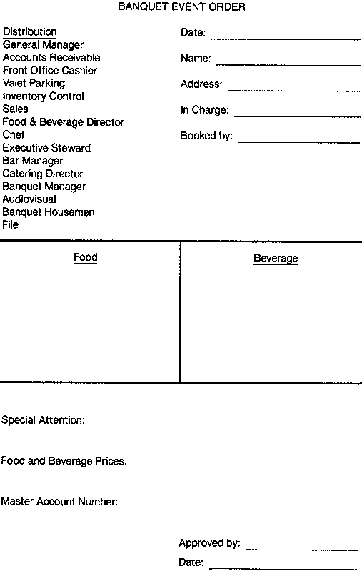
Preparing function sheets
A function sheet, sometimes also known as an ‘event order’ or ‘function order’, is an internal communication form developed to suit each venue’s needs that sets out the details of a function.
What information is included in a Function Sheet?
Notes:
Class Activity – Questions
Ask the question in the slide.

Slide 117
Preparing function sheets
Contents of a function sheet
Type of function
Name, address, and contact number of client
Day, date and time of the function
Rooms and locations
Billing instructions
Menu
Notes:
Class Activity – Discussion & Questions
Discuss points in the slide.
What information would you like to know under each point?
Type of function – wedding, launch of product, ball
Name, address, and contact number of client
Day, date and time of the function
Rooms and locations where the function will be held
Billing instructions – who gets the bill, their address
Menu – breakdown course by course of the agreed dishes including specification of ‘on arrival’ food, morning and afternoon teas.

Slide 118
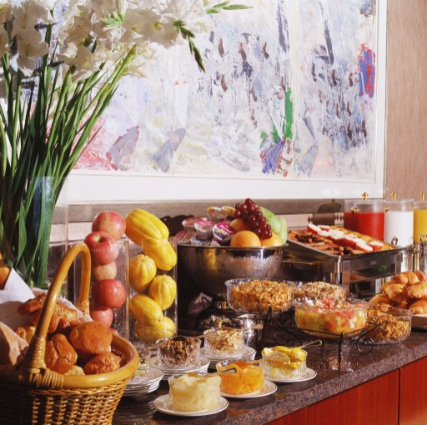
Preparing function sheets
Contents of a function sheet
Beverage arrangements
Sequence of service
Entertainment
Room set up
Type of service
Special requirements
Notes:
Class Activity – Discussion & Questions
Discuss points in the slide
What information would you like to know under each point?
Beverage arrangements – description and quantities of beverages to be provided
Sequence of service – covering timing of service, and details of when speeches and presentations will occur
Entertainment – details of bands and the order of ceremony.
Room set up – number of tables, floor plan, decorations, table set-ups including cutlery, crockery and table accoutrements
Type of service – plated, tray, buffet, silver service, finger food
Special requirements – commonly relating to technology requirements such as microphone, DVD facilities, data projector, sound and lighting.

Slide 119

Maintaining and updating Function Sheet
Whilst the Function Sheet may be accurate at the time of the function booking and confirmation, there will be changes which need to be updated and communicated to relevant internal departments and external suppliers.
Activities include:
Updating Function Sheet
Identification of changes
Discussing changes
Notes:
Class Activity – Discussion and Questions
Discuss points in the slide
What activities need to be conducted under each point?
How can different stakeholders be notified of changes in a timely manner?

Slide 120
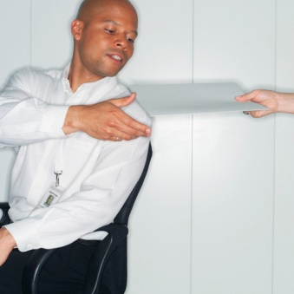
Keeping accurate records
Details kept in the file include anything to do with the function. This might include:
Contact details of client
Quotations provided to client
Quotations received from suppliers
List of charges
Special requirements
Records of suggestions
Case notes
Written correspondence
Copies of accounts
Notes:
Class Activity – Discussion & Questions
Why is it important to keep accurate records?
Who is responsible for it?
Where should records be kept?
How can any department access the most updated records?

Slide 121

Liaise with colleagues
All successful functions are a result of effective teamwork.
There is a need to involve others in the planning phase:
Who would you involve?
What help can they offer?
Notes:
Class Activity – Discussion and Questions
Ask questions in the slide.

Slide 122
Liaise with colleagues
Types of assistance
Seeking advice or suggestions
Confirming information
Updating them about preparations and purchases
Undertaking logistical activities and arrangements
Assisting them to meet function requirements
Notes:
Class Activity – Discussion
Discuss points in the slide.

Slide 123
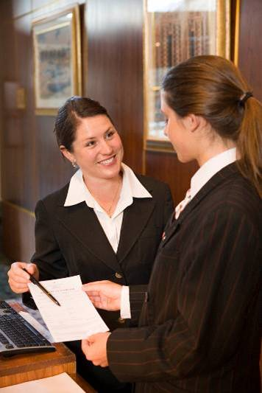
Liaise with colleagues
Who might be involved?
Executive Chef
Beverage Manager
Maintenance Department
Executive Housekeeper
Catering & Conference Coordinator
Purchasing Manager
Front Office Manager
Security
Notes:
Class Activity – Questions
What specialist advice can these people provide?
How is it best to involve them in the planning process?
Food requirements discussed with Executive Chef
Beverage requirements discussed with Beverage Manager
Technical requirements discussed with Maintenance Department or outside suppliers
Linen requirements discussed with housekeeping – outside suppliers may also be involved
Room decorations and floral arrangements discussed with housekeeping or outside suppliers
Facility set-up requirements discussed with Catering and Food and Beverage or functions coordinator.

Slide 124

Liaise with colleagues
What input can these people make?
Their previous experience
Their specialist areas of expertise
Their individual knowledge of:
The venue
What it can do
What it has to offer
What it has done successfully and unsuccessfully in the past
Notes:
Class Activity – Stories
Trainer and audience to share stories about assistance that was provided by other departments when preparing functions.

Slide 125

Rostering staff
One of the key requirements when planning for a function is to ensure that you are adequately staffed for the event
This is normally undertaken through the use of a roster
A roster is a plan that organises staff, indicating which staff are to work where and at what times
Notes:
Class Activity – Questions
Who is responsible for rostering?
What does rostering involve?
What is the purpose of a roster?

Slide 126
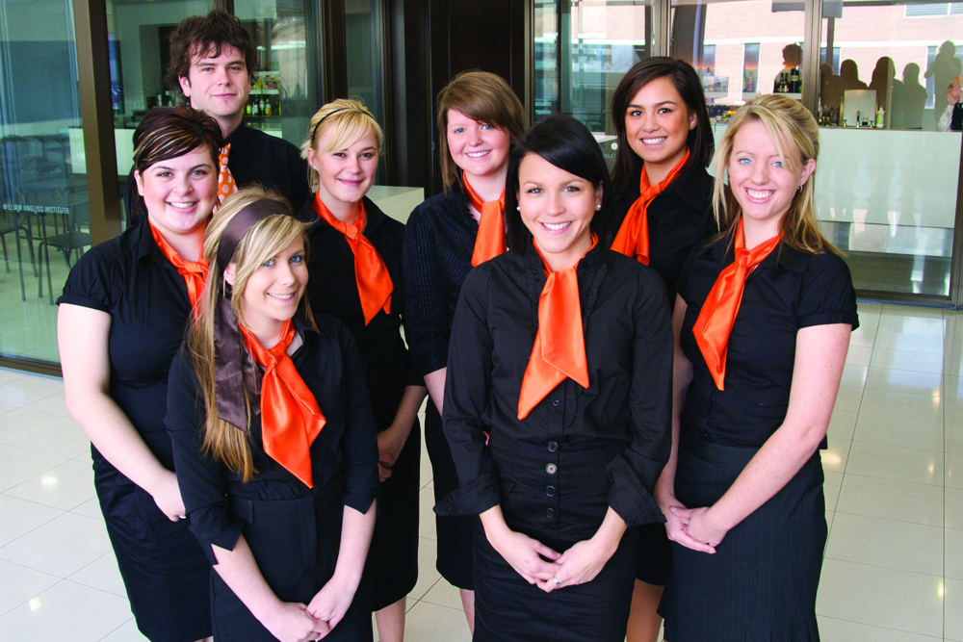
Rostering staff
Purpose of rosters
The purpose of rosters can be seen as ensuring that:
The right people
In the right number
Are employed at the right places
At the right time
Notes:
Class Activity – Discussion
Discuss the importance of these points.

Slide 127
Rostering staff
Reasons for having rosters
There are five reasons why organisations have rosters:
Organising staff
Balancing experienced staff
Communicating
Cost controlling
Aiding employees
Notes:
Class Activity – Discussion
Explain how these reasons are beneficial to management, staff and customers.

Slide 128
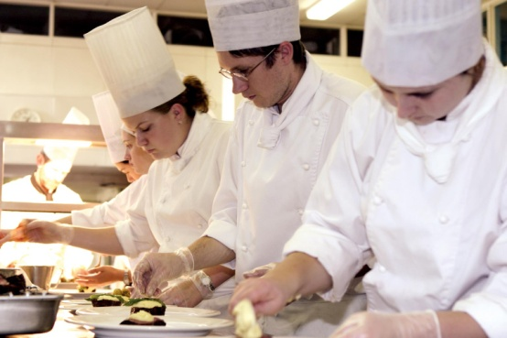
Rostering staff
Impacts on staffing
The amount and type of staff required to service a function will greatly depend on the:
Type of function
Service requirements
Numbers attending
Level of service required
Host of associated miscellaneous details
Notes:
Class Activity – Discussion
Explain how these points impact on rostering.

Slide 129
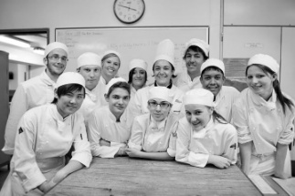
Rostering staff
Calculating staff numbers
Determining how many staff are needed or can be afforded to a function is based on a number of factors.
The following slides provide an overview of staffing needs for different function types.
What are these factors?
Notes:
Class Activity – Discussion
Get the audience to think of factors that will influence staff numbers.

Slide 130
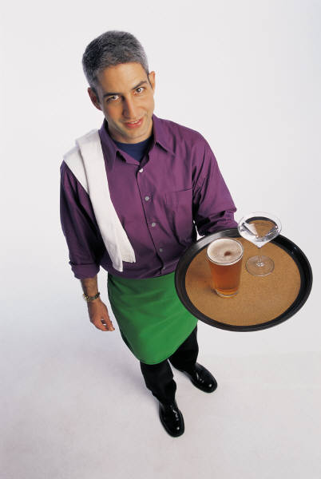
Rostering staff
Calculating staff numbers
Breakfast Function – Self-service – Continental Menu
Staff to set up and service the buffet
Staff to greet and seat customers
Waiting staff to clear away unwanted crockery, cutlery and glassware
Staff to clean up function and set for lunch
Notes:
Class Activity – Discussion
Explain how would you staff this type of function.

Slide 131
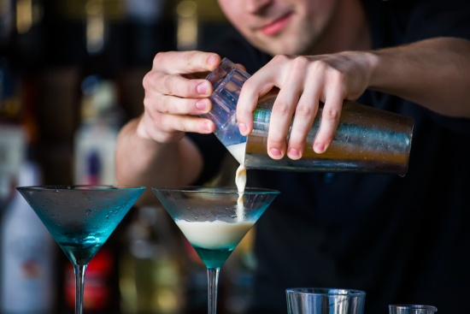
Rostering staff
Calculating staff numbers
Cocktail Party – Informal Function – Stand up
Staff to set up function area
Bar staff to set up and run the bar
Waiting staff to carry platters of food
Staff to clean up the area after function
Notes:
Class Activity – Discussion
Explain how would you staff this type of function.

Slide 132
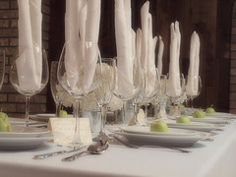
Rostering staff
Calculating staff numbers
Formal dinner party
Staff to set up function area
Bar staff to set up and run the bar
Waiting staff to provide semi-silver service to guests
Staff to clean up the area after function
Security staff
Notes:
Class Activity – Discussion
Explain how would you staff this type of function.

Slide 133

Rostering staff
Calculating staff numbers
General party
Staff to assist with decorations
Bar staff to set up and run the bar
Staff to coordinate and play music (DJ)
Staff to carry platters of food
Security staff
Notes:
Class Activity – Discussion
Explain how would you would staff this type of function.

Slide 134

Rostering staff
Productivity standards
Every job has standards of performance that are required to be met by the employee undertaking that job
‘Expected levels of output’
Notes:
Class Activity – Discussion
Why is it important to have productivity standards?
Where do these come from?

Slide 135
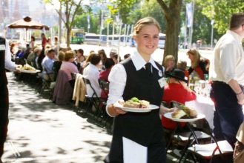
Rostering staff
Productivity standards
Performance standards are targets including:
Food waiters may be expected to serve X number of people
One bartender is used to serve X number of customers
Notes:
Class Activity – Discussion
What are different productivity standards for a variety of service styles?

Slide 136
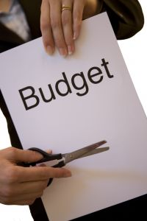
Rostering staff
Budget
Rosters of functions need to consider relevant staff budgets
The cost of employing someone does not just mean their wages, but also includes many other costs
Notes:
Class Activity – Questions
What are other costs that need to be taken into account?

Slide 137

Rostering staff
Allocating the right mix of staff
When rostering staff it is essential to use the available skill sets and competencies of available staff to match the type of function
Staff should complement each other and provide a balanced service
Notes:
Class Activity – Questions
What can you do to get the right mix?

Slide 138

Rostering staff
Factors influencing the mix of staff
The mix of staff should take into consideration:
Experienced staff and new staff
Permanent and casually employed staff
Males to females
Skilled employees to semi-skilled employees
Language skills
Notes:
Class Activity – Questions
Why are these mixes important?
What benefits does each type of staff member identified in this slide bring to a function?

Slide 139

Rostering staff
Accessing staff
In many cases, functions do not have a ready pool of staff available at its disposal to cater for an event and may need to access staff from different avenues
Where can you get staff from at short notice?
Notes:
Class Activity – Questions
Answer question in the slide.

Slide 140

Rostering staff
Accessing staff
Avenues include:
Other departments
Other hotels within the chain
Specialist contractors
Casual employment
Employment agencies
Using managers
Notes:
Class Activity – Questions
Which avenues would you draw upon first and why?
What are the benefits of using each of these sources?

Slide 141
Rostering staff
Confirming staff
Because events/functions are one-off in nature staff used on them will often need to be contacted to confirm:
Their availability
Their willingness to work
Confirmation of shift details
Notes:
Class Activity – Questions
What is the best way to contact staff, taking into account that many are casual workers?

Slide 142
Rostering staff
Methods of communicating confirmation
Because events/functions are one-off in nature staff used on them will often need to be contacted to confirm their participation. Ways to contact staff include:
Posted on the noticeboard within the workplace
Distributing hard copies to individual staff
Phoning or texting staff members
E-mailing electronic copies to staff
Distribution in meetings
Notes:
Class Activity – Questions
What are the benefits of each method?
Which methods are most used and why?

Slide 143

Minimise impact of function
Functions affecting other outlets
Most function departments within a hotel are very busy places, with a number of events being held at the same time.
It is important that each function does not greatly impact on:
Other functions
General hotel outlets
Notes:
Class Activity – Questions
What are common impacts that affect other functions or hotel outlets?
What can you do to minimise this impact?

Slide 144

Minimise impact of function
Impacts on functions
In addition, there may be impacts that will affect a function, either caused by:
Other functions
General hotel outlets
Factors outside the hotel
General environment
Notes:
Class Activity – Questions
What are common impacts that affect a function?
What can you do to minimise this impact?

Slide 145

Minimise impact of function
Impacts
Shortage of staff
Loss of power or IT connections
Equipment malfunctions
Excess noise affecting other areas of the business
Shortage of food and beverage products and any associated items
Notes:
Class Activity – Questions
What are the causes of these impacts?
What can you do to minimise this impact?

Slide 146

Minimise impact of function
Impacts
Unacceptable behaviour
Disruption to normal service caused by closure of room/areas
Restricted access to the venue
Reduced availability of parking for regular customers
Notes:
Class Activity – Questions
What are the causes of these impacts?
What can you do to minimise this impact?

Slide 147

Minimise impact of function
Adequate notification
Regardless of the activity that may impact on other customers and in-house guests, some advance notification should be given
What types of notification are appropriate and effective?
Notes:
Class Activity – Questions
Ask question in slide.

Slide 148

Minimise impact of function
Methods of suitable notification may include:
Signs in the foyer
Signs in elevators and bathrooms
Letters sent to guest rooms
Verbal explanation – at reception or by staff in other departments
Notes:
Class Activity – Questions
To whom are the notification methods addressed?
How else can you notify and prepare people?

Slide 149



Arrange external services
Many individual functions traditionally may require the use of specialised skills or equipment which may not be available within the organisation
At these times, external services will be utilised.
Notes:
Class Activity – Questions
What types of external businesses are utilised in functions?

Slide 150
Arrange external services
Types of external providers
Florists
Photographers
Party Hire companies
Entertainers
AV Technicians
Printers
Notes:
Class Activity – Questions
What specialist products or services do these businesses provide?

Slide 151

Arrange external services
Sourcing option
Like with any business, different companies will offer different products and services as a means of identifying their point of difference
It is a good idea to source at least three companies
Notes:
Class Activity – Questions
Where can you find information on different types of external suppliers?

Slide 152

Arrange external services
Liaising with providers to understand offering
Range of offering
Pricing structure for each item
Service guarantees
Availability
Pre-event services
Event services
Post-event services
Billing and payment arrangements
Notes:
Class Activity – Questions
What information would you like to know about external suppliers?
Range of offering – selection of products and services
Pricing structure for each item – including discounts or complimentary additional items
Service guarantees – what quality and quantity guarantees can they provide
Availability - how available are items. It is no use choosing a provider, no matter how cheap, if their items are never available
Pre-event services – delivery and setting up arrangements
Event services- what will the company do during the event to ensure its products or services operate as expected
Post-event services – take down and removal of items, cleaning etc
Billing and payment arrangements.

Slide 153

Arrange external services
Facilitating access by external providers
It is essential that providers understand:
What time they have access
Delivery and parking zones
Storage areas
Commencement and finishing times of the function
Amount of time allocated after the event for access
Notes:
Class Activity – Questions
Why is it important to discuss these points with external providers?
Trainer to provide examples of information that may be given to external suppliers in relation to each of these points.

Slide 154
Arrange external services
Connecting service providers with customer, where appropriate
In many cases functions staff will suggest that external providers correspond directly with the client because:
Functions staff do not have the technical knowledge or understanding
External providers can explain what they can offer and provide suggestions
Can remove a level of activity or responsibility from the functions department
Notes:
Class Activity – Discussion
Discuss points.

Slide 155
Purchase necessary stock
Stock is a very important aspect of a function and without it no function can take place.
Many functions require a wide variety of stock items which need to be arranged, whether:
Borrowed from other departments
Ordered internally through the purchasing department
Purchased or hired through external providers
Notes:
Class Activity – Research activity
Trainer to break the audience into small groups:
Give each group a specific type of function
Get them to identify the types of stock commonly used for that function
Get them to identify how these items can be arranged, taking into consideration the options provided in the slide.

Slide 156

Purchase necessary stock
Regardless of how stock is arranged it is essential that the:
Right stock is available
In the right amount
In the right condition
At the right time
Notes:
Class Activity – Questions
How do you know ‘how much’ will be needed?

Slide 157


Purchase necessary stock
Types of stock
Food and beverages
Decorations
Stationery
Equipment
Linen
Notes:
Class Activity – Discussion
Discuss the different types of stock.
Food and beverages to match identified menu selections
Decorations – including flowers, table decorations and displays, stage decorations, dance floors, bunting and other decorations as requested by customer
Stationery– such as meeting note pads, pens, folders, pencils, whiteboard markers, butcher’s paper, name card holder, name tags etc
Equipment – data projectors, whiteboards, DVD players, AV equipment etc. These items are normally hired as opposed to purchased
Linen – table covers, chair covers, napkins, skirting etc.

Slide 158

Purchase necessary stock
Types of stock
Crockery and glassware
Cleaning supplies
Consumables
Notes:
Class Activity – Discussion
Discuss the different types of stock.
Crockery and glassware
Cleaning supplies – such as cleaning chemicals (all-purpose cleaners, abrasive cleaners, deodorisers, window cleaners, carpet spot cleaner) and cleaning equipment (cleaning gloves, mops and buckets and machines such as vacuum cleaners, polishers etc.)
Consumables - such as toilet paper, rubbish bin liners, soap for use in public toilets, light globes, tissues, paper towels and so on.

Slide 159

Purchase necessary stock
Ordering stock externally
People who may have the authority to purchase items must be aware of:
Dollar limits that apply
Terms of trade
Preferred suppliers
Preferred in-house delivery requirements
Full establishment details
Documentation needed
Signatures or authorisations required
Notes:
Class Activity – Questions
Why is it important that people who purchase understand these points?

Slide 160
Purchase necessary stock
Purchase orders
To purchase a service or goods from an external supplier, whether arranged directly or through internal channels, in most cases you will be required to complete a purchase order form.
What information is included in a purchase order form?
Notes:
Class Activity – Questions
Ask question in slide.

Slide 161

Purchase necessary stock
Purchase orders information
Purchase order number
Supplier’s name, address, telephone number
Date of order
Description of the item and quantity required
Unit and total price for the hire/purchase
Notes:
Class Activity – Discussion and show how to complete a purchase order
Trainer to show audience different types of purchase orders.

Slide 162

Purchase necessary stock
Purchase orders information
Date and place of delivery of the items/services
Payment terms and conditions
Name, department and signature of person placing the order
Reason for the order
Notes:
Class Activity – Discussion & Show how to complete a purchase order
Trainer to show audience different types of purchase orders.

Slide 163

Delivery of stock
Delivery of stock
All incoming stock must be checked against purchase and supply agreements, in all necessary details.
What do you check?
What do you do with the stock once it is checked?
What do you do if the items are incorrect?
Notes:
Class Activity – Questions
Ask question in slide.

Slide 164

Delivery of stock
Checking deliveries
When checking a delivery, your aim is to
confirm:
All items ordered have been supplied
All items listed on the paperwork have been delivered
All items delivered are in good condition
Ensure items are of the correct size
Ensure items are of the correct quality
Ensure the correct price has been charged
Notes:
Class Activity – Questions
Why are these checking tasks important?

Slide 165
Prepare Running Sheet
Along with a copy of the Function Sheet, it is common house policy to present the client with a Running Sheet for their function
What is the difference between a Function Sheet and a Running Sheet?
What is the purpose of a Running Sheet?
Guest arrival | 6:30PM
Pre-dinner drinks | 6:45PM
Seated for dinner | 7:15PM
Entree | 7:20PM
Speech and presentation | 7:45PM
Main course | 8:15PM
Entertainment | 9:00PM
Dessert/coffee | 9:30PM
Departure | 10:30PM
Notes:
Class Activity – Questions
What is the difference between a Function Sheet and a Running Sheet?
What is the purpose of a Running Sheet?

Slide 166
Prepare Running Sheet
A Running Sheet identifies:
Timing of different activities
Supporting resources
Actions
Responsibilities
Notes:
Class Activity – Questions
Why are these inclusions important?

Slide 167
Prepare Running Sheet
Benefits of timing
Determining the appropriate times for the different stages of the function will ensure provisions can be timed and coordinated to coincide with the client’s timing requirements:
Food and beverage service
Technical arrangements
Other service requirements
Notes:
Class Activity – Discussion & Show Running Sheets
Discuss points
Trainer to collect and show examples of different running sheets.

Slide 168
Prepare Running Sheet
Explaining Running Sheets
Not only is it important that all relevant personnel have received a copy of the Running Sheet, but it is vital that they understand:
Their role in the function
How their role needs to interact with others
Notes:
Class Activity – Questions
What is the best way to communicate Running Sheet information with relevant stakeholders?

Slide 169

Conduct pre-function briefings
The best way to communicate to staff the requirements of an event is in the form of a pre-function briefing when staff are all together.
What needs to be discussed?
Who should attend?
Notes:
Class Activity – Questions
Ask questions in the slide.

Slide 170

Conduct pre-function briefings
Who should attend?
Heads of Departments
Waiting staff
Beverage staff
Security staff
Storeroom staff
Technical staff
Third party suppliers
The client or their representatives
Notes:
Class Activity – Questions
Why do these people need to attend?
Who else would you invite to participate in these briefings?

Slide 171

Conduct pre-function briefings
Contents of a briefing
The briefing should cover any relevant information and important points about the function and include distribution of the latest running sheet to staff.
What should be covered in a briefing?
Notes:
Class Activity – Questions
What should be covered in a briefing?

Slide 172

Conduct pre-function briefings
Contents of a briefing
Identifying customer and attendees to staff
Overview of the function
Describing anticipated/planned function
Last minute changes to the running sheet
Special requests made by the client
Particular issues the venue expects with certain aspects of the function
Notes:
Class Activity – Discussion
What particular information is covered in each of these points?

Slide 173

Conduct pre-function briefings
Contents of a briefing
Identifying options that exist for service recovery
Presentation of service standards
Security issues
Clarification of ‘chain of command’ for all staff
Arrangements for security, media access, meals, photo/filming opportunities, passes etc.
Specific ‘Do’s and don’ts’ for the function
Notes:
Class Activity – Discussion
What particular information is covered in each of these points?

Slide 174

Conduct pre-function briefings
Contents of a briefing
Allocating roles and responsibilities
Allocation of specific duties to specific staff
Allocating stations to waiting staff
Explain seating plan
Notes:
Class Activity – Discussion
What particular information is covered in each of these points?

Slide 175

Conduct pre-function briefings
Contents of a briefing
Any last minute changes
Checking uniforms and personal presentation of staff
Completing time sheets
Discussing timing of staff breaks
Notes:
Class Activity – Discussion
What particular information is covered in each of these points?

Slide 176

Finalising function details
Now that the function is just around the corner, it is essential that any outstanding details are confirmed with the client and communicated to all relevant stakeholders.
What activities need to be undertaken to confirm all final function requirements?
Notes:
Class Activity – Questions
Ask questions in the slide.

Slide 177

Finalising function details
Finalising function details may include:
Meeting with the customer
Accommodating last minute changes as requested by customer
Obtaining additional deposit
Confirming amended details as set out in Function Sheet
Notes:
Class Activity – Questions
What actions are required for each point?

Slide 178
Finalising function details
Distribute final Running Sheet
Function coordinator distributes personally to all those involved:
Posting on departmental notice boards
Giving multiple copies to departmental heads for them to distribute to staff
Email
Phoning – especially external suppliers
Notes:
Class Activity – Questions
What is the best method when changes need to be relayed in an immediate fashion?

Slide 179

Monitor set up of function
It is critical to have the function set up and ready to go by the agreed starting time
A key objective when monitoring set up for a function is that all necessary mise-en-place is completed
Notes:
Class Activity – Questions
What does the term mise-en-place mean?

Slide 180

Mise-en-place
Mise-en-place is a French term that means ‘to put in place’.
Therefore, ‘set up and mise-en-place’ refers to all the activities required to prepare the room for service
What mise-en-place activities need to be undertaken when preparing a function?
Notes:
Class Activity – List mise-en-place activities
Trainer to break audience into groups
Give each group one job role
Get them to identify all mise-en-place activities that would need to be completed before a function.

Slide 181

Mise-en-place
Set up policies and procedures
Following prescribed safety procedures
Adhering to safe food handling practices
Staying within allocated scopes of responsibility
Discharging all tasks to the best of your ability
Notes:
Class Activity – Questions
Why is it important to have policies and procedures when setting up a function?
What is the difference between a policy and a procedure?

Slide 182
Mise-en-place
Set up policies and procedures
Ensuring that all allocated tasks have been completed
Notifying management of a problem or hazard
Working only the allocated hours as stated on the roster
Notes:
Class Activity – Questions
What specific policies must staff follow?
What specific procedures must staff follow?

Slide 183

Using checklists
Importance of Checklists
An industry-wide method of monitoring completion and performance of activities is to use a series of checklists
Notes:
Class Activity – Questions
What is the purpose of a checklist?
What information should be included in a checklist?

Slide 184
Using checklists
Benefits of Checklists
Remind staff of what needs to take place
It helps ensure activities are not forgotten
Can easily be used by management and staff to see that activities have been:
Completed
By whom
At what time
Notes:
Class Activity – Discussion
Discuss the benefits.

Slide 185
Using checklists
The use of checklists by supervisors
No aspect of the job is left out
Consistency across all staff whose performance is being monitored
Subjectivity in monitoring
Matters that are regularly occurring as non-compliance issues can be identified
Notes:
Class Activity – Discussion
Discuss the benefits.

Slide 186

Planning set up
Many venues will have plans of previous function set-ups to guide set-ups.
In all instances the room set-up must be in accordance with client wishes as set out in the contract.
What needs to be planned?
Notes:
Class Activity – Questions
What needs to be planned?
What influences planning?

Slide 187

Planning set up
Setting up tables
When setting up the relevant locations the function sheet should be referred to in order to determine the need for specific furniture such as:
Display tables
Registration tables
Tables for merchandise and delegate materials, catering and IT requirements
Notes:
Class Activity – Questions
What are other considerations when setting up tables for different events?

Slide 188
Mise-en-place
Floor-related mise-en-place tasks
Preparing, polishing and setting glasses on each table at each setting
Preparing crockery and cutlery
Checking support items are ready
Folding napkins
Preparing condiments
Notes:
Class Activity – Discuss and demonstrate mise-en-place activities
Preparing, polishing and setting glasses on each table at each setting including the equipment to ensure that glassware is available and has been prepared to support the service of special beverages as required for the function.
Preparing crockery and cutlery – for placement on tables. Most premises require crockery to be checked to ensure it is clean and free of chips or cracks and that cutlery is to be polished prior to being set up.
Checking that items required to support the service of menu items as listed are ready and available. This can include:
Platters, lids and covers
Service utensils – such as spoons and forks for silver service, tongs, cake lifts and stands, sauce boats and underliners
Oven-to-tableware – this is commonly the responsibility of kitchen staff but waiting staff may be responsible for ensuring the stands or mats that these hot items are placed on are ready and available
Folding napkins – including the preparation of waiter’s cloths/napkins ready for use on clothed service plates
Preparing condiments – including re-filling, cleaning and placement on tables and in waiter’s stations.

Slide 189

Mise-en-place
Floor-related mise-en-place tasks
Preparing butters
Readying all equipment
Checking or preparing display materials
Preparing and checking operational readiness of cash registers
Notes:
Class Activity – Discuss and demonstrate mise-en-place activities
Preparing butters – including spares to cater for situations where extra butter is required
Readying all equipment – such as espresso machines, tea and coffee-making equipment, bain maries, waiter’s stations
Checking or preparing display materials – some properties will feature a display table to fit in with a theme
Preparing and checking operational readiness of cash registers where a cash service is operating. This can include collecting and counting the float, obtaining change, checking the audit tape is sufficient for the upcoming session, and ensuring date/time is correct. This may be the role of bar staff in some venues where accounts are processed through the bar register.

Slide 190


Mise-en-place
Floor related mise-en-place tasks
Checking table dressings
Linen presentation
Paper overlays and serviettes
Placemats
Glassware
Service wear and flatware
Floral arrangements
Condiments
Table numbers
Notes:
Class Activity – Discuss and demonstrate mise-en-place activities
Linen presentation – checking the serviette fold used is as required, that napkin folds are uniform, clean and attractive, that overlays have been used as intended
Paper overlays and serviettes – depending on the style or standard of the room, there may be a requirement that paper items are used as opposed to linen ones
Placemats – checking cleanliness
Glassware – to reflect house policy or function requirements
Servicewear and flatware – making sure that necessary quantities of normal servicewear is ready for use, and that special items are available to suit identified guest needs
Floral arrangements – checking bud vases for acceptable appearance and to make sure they are in position
Condiments – checking they are present, clean and filled
Table numbers – where they are used, checking to make sure all tables have numbers that reflect the floor plan/table plan.

Slide 191

Mise-en-place
Floor-related mise-en-place tasks
Setting the tables
Tables must be set to:
Reflect the menu that is being used for the function
Reflect the floor/table plan that has been prepared
Comply with house and function requirements
Ensure uniformity throughout the room
Notes:
Class Activity – Discuss and demonstrate mise-en-place activities
Tables must be set to:
Reflect the menu that is being used for the function
Reflect the floor/table plan that has been prepared
Comply with house and function requirements – relating to table dressings, colours of tablecloths, overlays, napkins. It also includes function preferences for things such as placement of wine glasses on the table for each cover/setting
Ensure uniformity throughout the room – table set ups should be the same across the room.

Slide 192

Mise-en-place
Floor related mise-en-place tasks
Tables and chairs should be checked prior to service to ensure:
Guest comfort
Guest safety
Appropriate access
Notes:
Class Activity – Discuss and demonstrate mise-en-place activities
Tables and chairs should be checked prior to service to ensure:
Guest comfort – tables and chairs that are unstable reduce the level of guest satisfaction, enjoyment and comfort with their service experience;
Guest safety – checks should ensure the furniture is ‘fit for purpose’ and does not present a hazard to those using it: checks should ensure nothing is broken
Appropriate access – so that guests can freely gain access to their seats and move safely throughout the room. Special care and action may need to be taken where wheelchair access is required and where gueridon trolleys are going to be used. In addition there must be adequate room for functions service staff to move in an efficient manner.

Slide 193

Mise-en-place
Bar related mise-en-place tasks
Storing beverages that have been delivered to the bar
Preparing bar garnishes
Preparing ice
Preparing and checking operational readiness of cash registers
Checking to see that all beverages listed on running sheets are available
Notes:
Class Activity – Discuss and demonstrate mise-en-place activities
Storing beverages that have been delivered to the bar where stock is waiting to be put away. This is usually the first job to do in order to get drinks that require refrigeration into the fridges as soon as possible. All stock should be rotated using the First In, First Out (FIFO) method meaning that existing stock should be moved forward and the new stock stored behind it
Preparing bar garnishes. These should include the basic lemon and orange slices and lime quarters as well as more sophisticated garnishes for any cocktails that are being offered as part of the function
Preparing ice including obtaining ice, crushing ice and readying ice buckets and stands
Preparing and checking operational readiness of cash registers if a cash bar system is operating
Checking to see that all beverages listed on running sheets are available and noting those that are not for mention at the staff briefing or ordering replacement stock as required.

Slide 194

Mise-en-place
Bar related mise-en-place tasks
Checking the post-mix
Turning on espresso coffee machine
Setting out drip trays
Setting out undertrays and racks for dirty glassware
Checking equipment and bar utensils are clean and in working order
Notes:
Class Activity – Discuss and demonstrate mise-en-place activities
Checking the post-mix to make sure it is fully operational for all flavours and the water button, and is being delivered at the right temperature and strength
Turning on espresso coffee machine
Setting out drip trays with denaturing agent
Setting out undertrays and racks for dirty glassware
Checking equipment and bar utensils are clean and in working order. This check should include all operational bar equipment.

Slide 195
Mise-en-place
Bar related mise-en-place tasks
Checking glassware to ensure no cracks, chips, lipstick marks etc.
Placing spirit pourers on the appropriate bottles
Stacking and ensuring cleanliness of service trays
Filling up ice buckets
Opening pre-selected wines
Notes:
Class Activity – Discuss and demonstrate mise-en-place activities
Checking glassware to ensure no cracks, chips, lipstick marks etc. are present
Placing spirit pourers on the appropriate bottles ensuring sufficient supply of liquor
Stacking and ensuring cleanliness of service trays
Filling up ice buckets
Opening pre-selected wines.

Slide 196
Mise-en-place
Bar related mise-en-place tasks
Preparing and filling water jugs or other items
Preparing pre-ordered drinks
Set out appropriate glassware on the tables
Preparing service trays and drinks
Notes:
Class Activity – Discuss and demonstrate mise-en-place activities
Preparing and filling water jugs or other items that are to be pre-placed on function tables
Prepare pre-ordered drinks
Bar staff may also be required to set out appropriate glassware on the tables and to prepare service trays and drinks for, say, pre-function drinks in the lobby or champagne.

Slide 197

Monitor service delivery
Not only is it important that activities are monitored in the lead up to a function, it is absolutely essential that they are monitored as the function is taking place
Managers must ensure that work activities designated to staff or which make up their job role, must be completed in an acceptable manner within the desired timeframes
Notes:
Class Activity – Questions
Why is it important to monitor service delivery?
How can you do it?

Slide 198

Monitor service delivery
Common monitoring methods
Workplace observation
Talking to staff
Feedback from the function co-ordinator or customers of the function
Notes:
Class Activity – Questions
Which is the most effective method?
What information can be obtained from each method?
Workplace observation – watching what goes on as it happens, reading customer body language and measuring waiting times
Talking to staff – to get their impressions, to identify obstacles that will impact on the ability to perform function activities
Feedback from the function coordinator or customers of the function. Constant liaison with the client or their delegated representative is a given in large functions where there are multiple sites and multiple activities.

Slide 199

Monitoring the function
Areas to monitor
Checking running times
Adjusting service delivery to align with Running Sheet
Arranging changes to the agreed Running Sheet to accommodate the need to do so
Ensuring quality service delivery
Ensuring all customer requirements are met
Notes:
Class Activity – Questions
For each of these points:
Why is it important to monitor it?
How can you monitor it?

Slide 200
Monitoring the function
Areas to monitor
Responding to queries and requests from clients and guests
Liaising with customer during function to check level of satisfaction
Enquiring if customer has additional requirements during service
Providing additional items as required
Clearing rubbish and used items
Notes:
Class Activity – Questions
For each of these points:
Why is it important to monitor it?
How can you monitor it?

Slide 201

Taking action to address service problems
It is a fact of life there will be problems of some sort at any function
Even where appropriate planning and preparation has taken place it is still likely there will be problems
Problems may be caused by equipment failure, shortage of materials, patrons. Many problems relate to timing issues
Notes:
Class Activity – Questions
What are common problems that occur?
What are the causes?
How can you reduce their occurrence?
How can you reduce its impact on customers?

Slide 202

Taking action to address service problems
Actively monitor all aspects of the function
Communicate with relevant people about what is happening
Take immediate action
As soon as you notice a problem or a timing issue you have to immediately begin to do something to resolve or address the situation.
Notes:
Class Activity – Share stories about problems and how they were or could have been resolved
Trainer to get audience to share stories, where they were staff or customers at a function where problems took place.

Slide 203

Element 4:
Follow-up after functions
Notes:
Introduce topic.
Class Activity – General Discussion
Ask general questions:
What activities need to be undertaken after the completion of a function?

Slide 204
Follow-up after functions
Performance Criteria for this Element are:
Obtain feedback from customer
Obtain payment for function
Debrief staff
Notes:
Trainer identifies the Performance Criteria for this Element, as listed on the slide.

Slide 205

Obtain feedback from customers
It should be standard practice during and after every function to seek feedback that may be used to assist in the planning and implementation of future functions.
When is the best time to get feedback?
How can you get feedback?
What do you want to know?
Notes:
Class Activity – Questions
Ask questions in the slide.

Slide 206
Client feedback
During the function
An important task is to seek feedback from the client and guests during the course of a function.
Positive feedback confirms the function is running as expected and expectations are being met
Negative feedback provides an opportunity to rectify a less than satisfactory situation
Notes:
Class Activity – Questions
What are common types of negative feedback?
What should you do in response to negative feedback?
What should you do in response to positive feedback?

Slide 207

Client feedback
After the function
After the function it is good industry practice to speak or meet with the client to determine their level of satisfaction and seek feedback
It is important the venue identifies anything that failed to meet promises or expectations so they can be flagged for extra attention in forthcoming functions
Notes:
Class Activity – Questions
How can you obtain feedback after the function?

Slide 208

Staff feedback
Staff feedback is vital, given that they are the people who can provide a firsthand account of how the event went.
Positive feedback reaffirms the current procedures are working well
Negative feedback may indicate current procedures and methods need to be revised
Notes:
Class Activity – Questions
Why is it important to get feedback from staff?
What methods can you use to get this feedback?
How do you get honest feedback?

Slide 209

Staff feedback
Group staff feedback
Staff feedback, which can form part of an individual group discussion, will focus on trying to identify:
What went right and how this can be replicated
What went wrong and what changes need to be made to correct this in the future
Any ideas or suggestions for improvement
Notes:
Class Activity – Questions
How is this method different in getting feedback as opposed to one on one discussions?

Slide 210

External provider feedback
Matters which could be addressed include:
Did they have sufficient information to enable them to provide the goods and services?
What extra information do they need next time?
What issues were evident?
What suggestions do they have that may assist in the planning and execution of future functions?
Notes:
Class Activity – Questions
What is the best way to get feedback from external providers?
What do you want to know from them?

Slide 211

Obtain payment for function
Once the function has been concluded and all the feedback has been collected by the customer, it is now time for the client to settle the account.
What steps are involved in preparing the account?
How can a client settle an account?
What happens if the client doesn’t agree with the price?
What if they don’t pay?
Notes:
Class Activity – Questions
Ask questions in the slide.

Slide 212

Preparing the account
Possible charges
Charges may include:
Food and beverage
Entertainment
Venue hire
Labour
Notes:
Class Activity – Discussion
Discuss these charges.
Food and beverage – as per initial agreement, taking into account adjustments ‘on the day’
Entertainment – bands, artists, personalities
Venue hire – fees for rooms
Labour – technical and service staff to set up rooms, activities or operate equipment during the function.

Slide 213


Preparing the account
Possible charges
Flowers
Audio-visual equipment hire
Printing, photocopying, secretarial services, phone and fax usage
Ice or margarine carvings, balloons, streamers and other specialised decorations
Dance floor hire
Notes:
Class Activity – Discussion
Discuss these charges.

Slide 214

Preparing the account
Verifying the account with management
Before the account is presented to the client it should be shown to management:
For their final approval
So all charges may be verified
All monies expended may be recouped
Notes:
Class Activity – Discussion
Why is this important?

Slide 215

Preparing the account
Presenting the account
A copy of the account must then be presented to the correct person
Care must be taken here to ensure that the ‘right’ person gets the bill
Notes:
Class Activity – Questions
How do you know who is the right person?
When should it be presented?
What is the best format to present it in?
What should you do when presenting the account?

Slide 216

Preparing the account
Methods of payment
What methods of payment are acceptable for a function?
When does an account need to be paid by?
Notes:
Class Activity – Discussion
Discuss the payment process.

Slide 217

Complete administration documentation
It is quite common for the Functions manager to complete a range of documentation at the completion of a function
There is generally an urgency associated with this as the venue will commonly seek to finalise this aspect of the function as soon as possible
Notes:
Class Activity – Questions
What documentation needs to be prepared and finalised?

Slide 218

Complete administration documentation
Collating feedback
Paying out monies to any entertainers or outside suppliers
Receiving final payment of the client’s account
Signing off staff time sheets
Checking the facilities to determine if repairs are need
Notes:
Class Activity – Discussion
Discuss these administration tasks.

Slide 219

Complete administration documentation
Processing payment and posting payment record on account
Issuing receipt and ‘Thank you’ letter to the client
Completing a feedback form
Preparing final comments about the function
Identifying preferences that may be helpful for future functions by the client
Notes:
Class Activity – Discussion
Discuss these administration tasks.

Slide 220

Complete administration documentation
Adding customer comment cards
Adding photos taken onto a database to be used as a marketing tool
Finalising all financial documentation including closure of accounts and printing of final accounts and payments
Storing the account file in an appropriate storage folder or area
Notes:
Class Activity – Discussion
Discuss these administration tasks.

Slide 221
De-brief staff
In the same way that some properties encourage or require supervisors to hold a briefing session with staff at the start of a session, they also encourage a debriefing session to be held at the completion of the session.
Notes:
Class Activity – Questions
What should be asked in a debrief?
When should it be done?
Who should attend?

Slide 222
Debrief staff
Topics in a debriefing session
Congratulating staff on work
Discussing staffing issues
Get suggestions from staff
Highlighting problems and issues that arose
Providing the staff with feedback
Notes:
Class Activity – Discussion
Discuss the topics.
Congratulating staff on work that has been well done during service
Discussing staffing issues including:
Staffing levels
Rostered start and finish times – including breaks, where applicable
Skill levels required or found to be missing
Suggestions from staff regarding improvements that could be made to the implementation of future functions.
Highlighting and leading discussion on problems and issues that arose with a view to determining what went wrong and how a similar event can be avoided in the future
Providing the staff with feedback on their perspective of how the session went and providing feedback they have captured from others such as customers, management or other departments.

Slide 223

De-brief staff
Topics in a debriefing session
Discussing feedback received by staff from those who attended
Reviewing the quality of service delivery provided
Encouraging staff to identify issues of concern to them
Discussing patron issues
Notes:
Class Activity – Discussion
Discuss the topics.
Discussing feedback received by staff from those who attended
Reviewing the quality of service delivery provided with a view to identifying changes that could lead to possible improvements in service delivery
Encouraging staff to identify issues of concern to them including identification of problems they have found with equipment etc., suspicious persons, procedures that are not working effectively
Discussing patron issues regarding access, behaviour, intoxication, knowledge about the function.

Slide 224
De-brief staff
Topics in a debriefing session
Discussing operation of ancillary services provided as part of the function
Presenting issues or details of next shift
Determining staff who will work on future functions
Thanking staff for their efforts and contribution
Notes:
Class Activity – Discussion
Discuss the topics.
Discussing operation of ancillary services provided as part of the function such as accommodation, parking, participation in activities, access and use of inclusions
Presenting issues or details of what can be expected in the next session
Determining staff who will work on future functions
Thanking staff for their efforts and contribution.

Slide 225

The End:
Thank you!
Notes:
This is the conclusion of the subject.
Thank the audience and deliver assessments as required.

